Slide 1
Welcome

Slide 2
Engr.Md.Musharraf Hossain
Teacher’s Identity
Bangladesh Sweden Polytechnic Institute
Kaptai,Rangamati.

Slide 3
STUDENT’S IDENTITY
6TH SEMESTER
CONSTRUCTION TECHNOLOGY
SUB : DESIGN OF STRUCTURE–1
SUBJECT CODE - 66463
TIME : 45 MINUTES

Slide 4
PREE LESSION
Flexure formula and Design of RCC Rectangular beam in WSD.

Slide 5
Today’s Lesson
Flexure formula and Design of RCC Rectangular beam in USD.

Slide 6
Learning Out Come
After the lesson student should be able to:-
Tell what is Flexure formula .
Tell what is the assumptions of flexure formula.
Tell what is Resisting moment of concrete.
Tell what is Resisting moment of steel.
Tell what is Bending moment.
Tell what is moment.

Slide 7
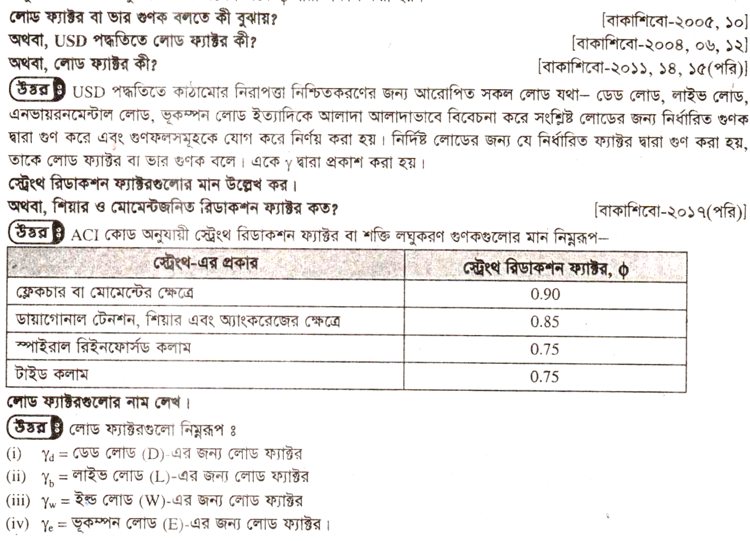
Presentation of lesson

Slide 9
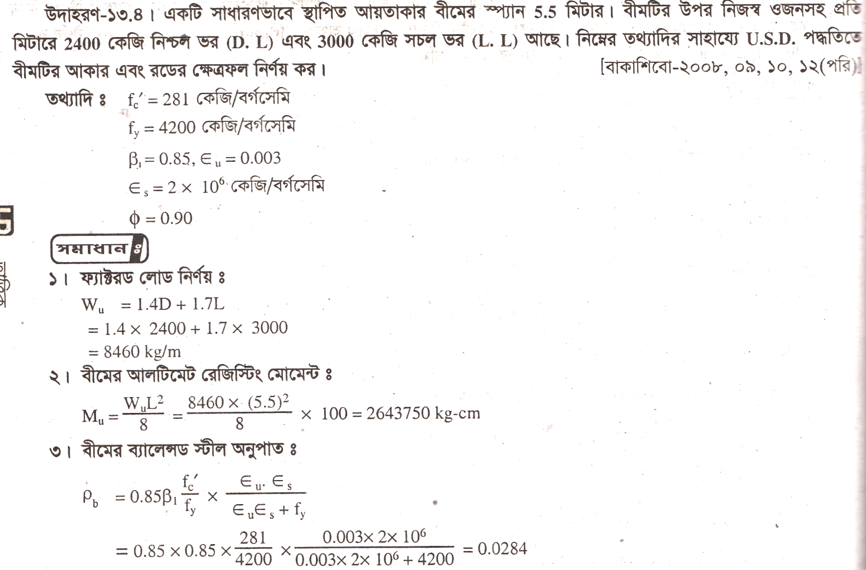

Slide 10
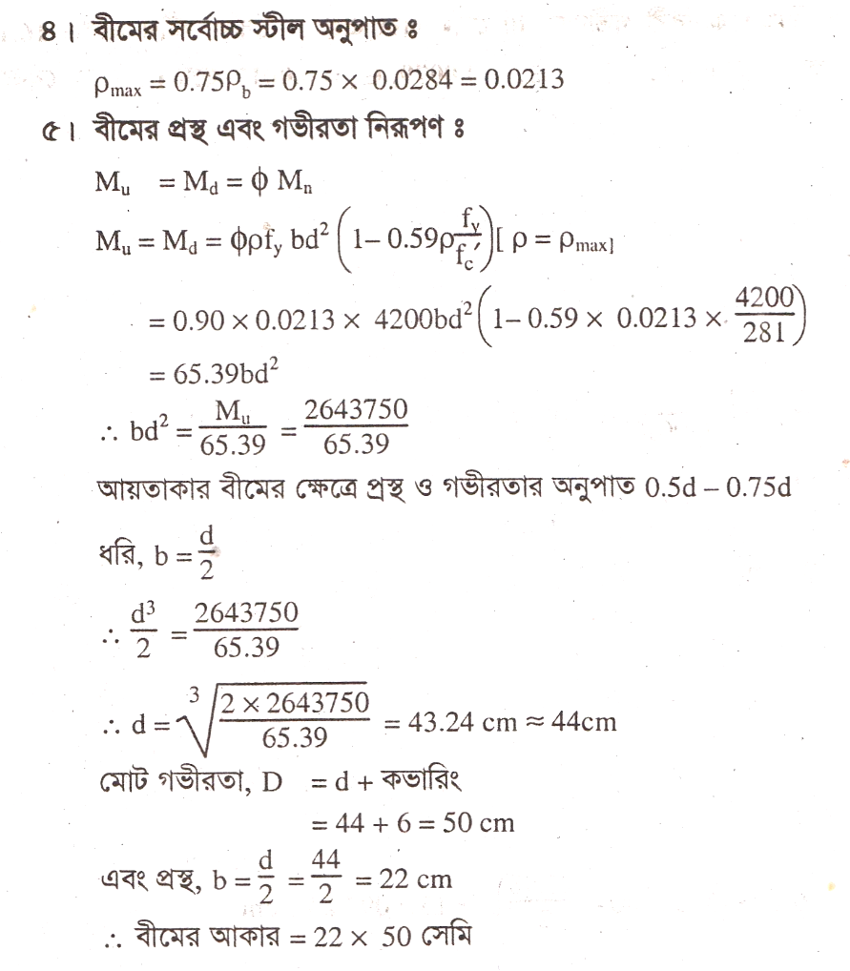

Slide 11
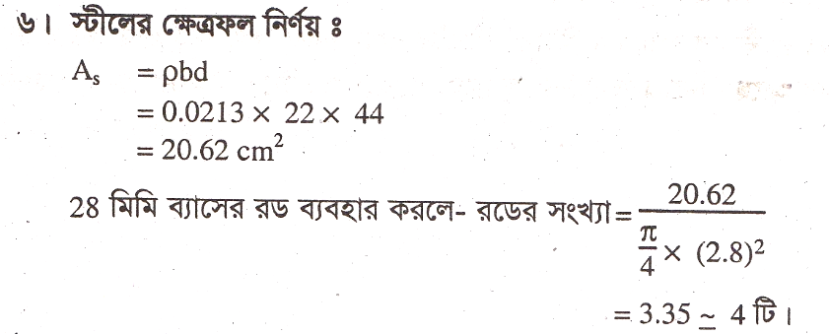

Slide 13
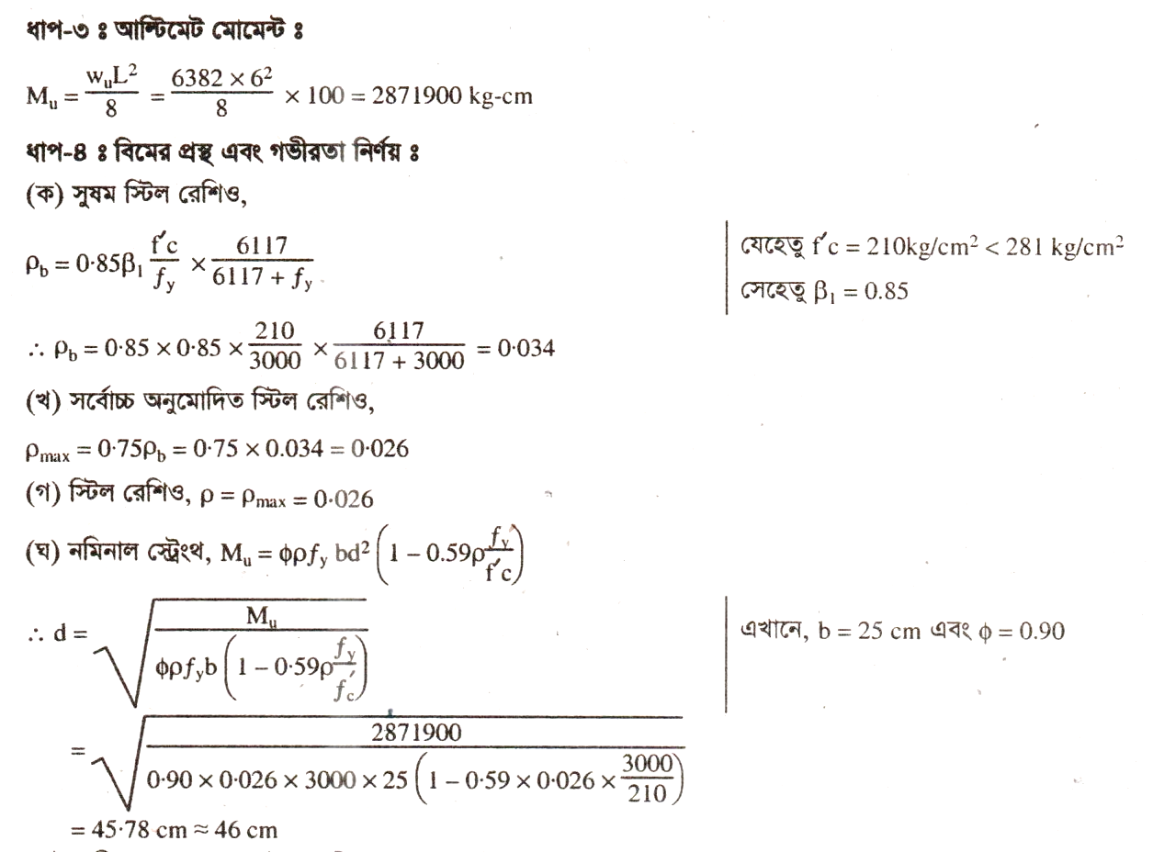

Slide 14
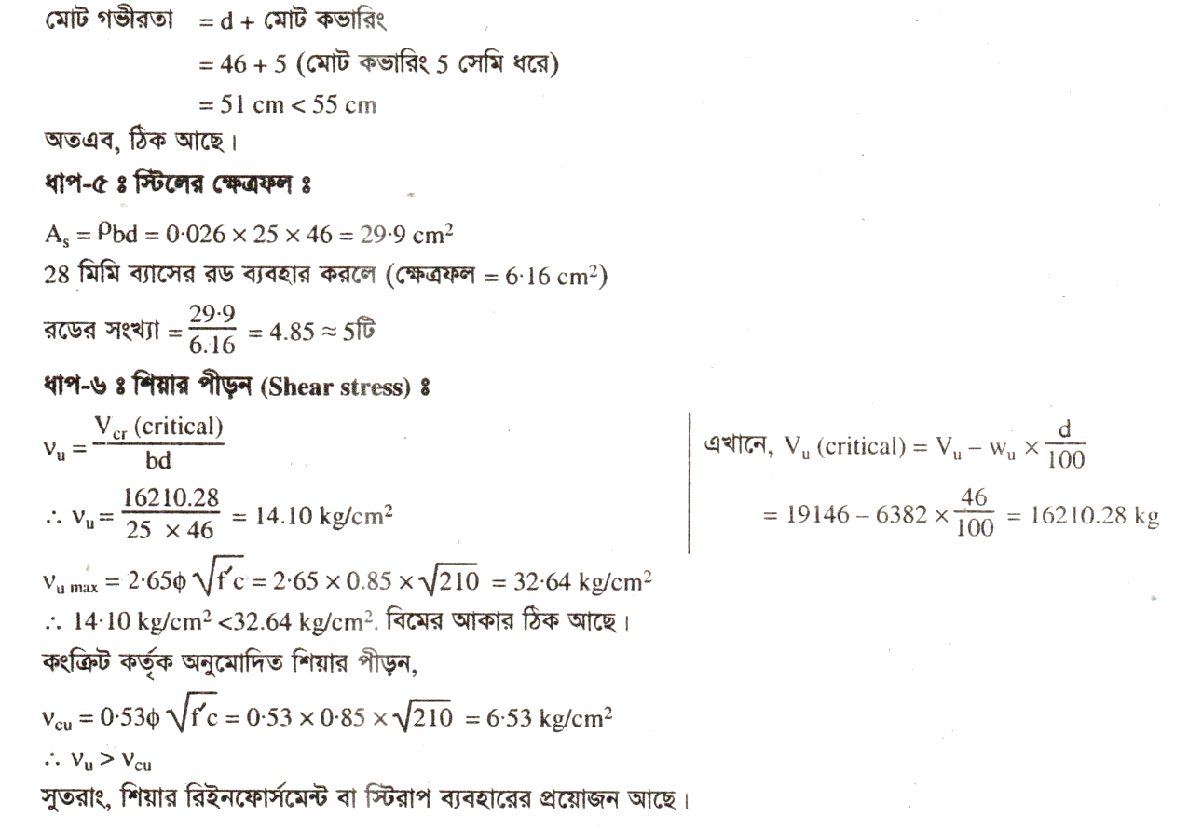

Slide 15
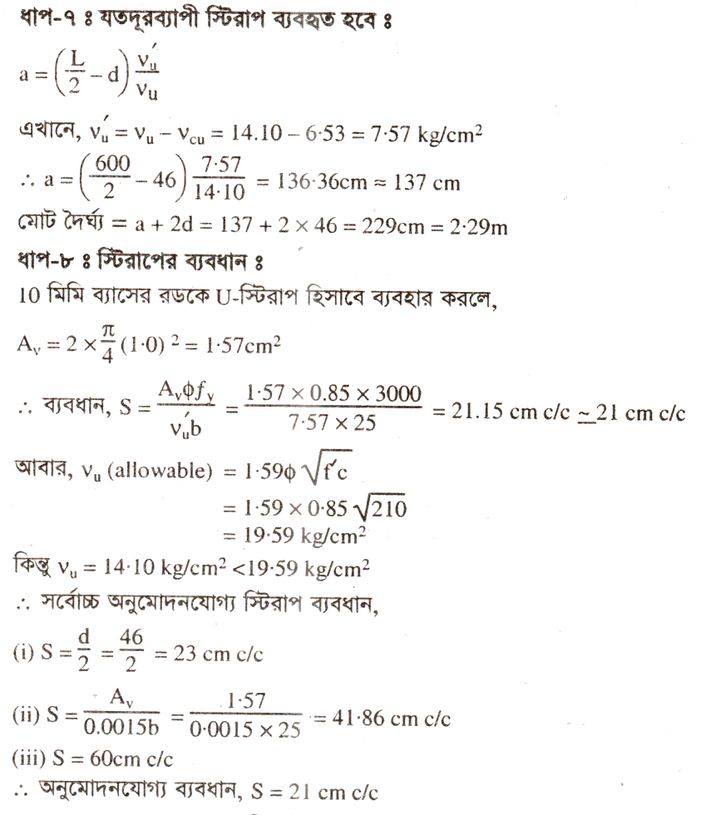

Slide 16
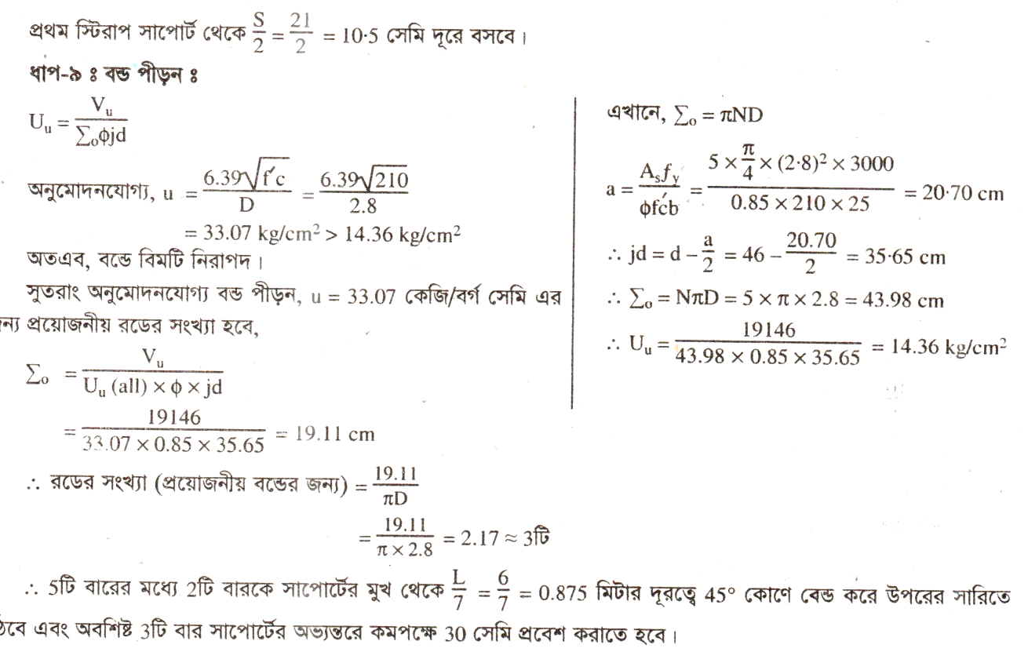

Slide 17
Evaluation
What is Flexure formula .
What is Resisting moment of concrete .
What is Resisting moment of steel.
What is Bending moment.
What is Moment
What is the assumptions of flexure formula.

Slide 18
Home Work
Derive the Flexure formula for R.C.C Beam in USD method.

Slide 19
Next Lesson
Cantilever and Overhanging Rectangular Beam Design in WSD

Slide 20
THANKS TO ALL

