Slide 1
Welcome

Slide 2
Engr.Md.Musharraf Hossain
Teacher’s Identity
Bangladesh Sweden Polytechnic Institute
Kaptai,Rangamati.

Slide 3
STUDENT’S IDENTITY
6TH SEMESTER
CONSTRUCTION TECHNOLOGY
SUB : DESIGN OF STRUCTURE–1
SUBJECT CODE - 66463
TIME : 45 MINUTES

Slide 4
PREE LESSION
Function of Web Reinforcement in RCC Beam

Slide 5
Today’s Lesson
Bond Stress Developed in RCC Beam

Slide 6
Learning Out Come
After the lesson student should be able to:-
Tell what is diagonal tension .
Tell what is the causes of diagonal tension .
Tell what is shearing stress.
Tell what is critical shear stress.
Tell what is Stirrup.
Tell what is prevention for diagonal tension .

Slide 7
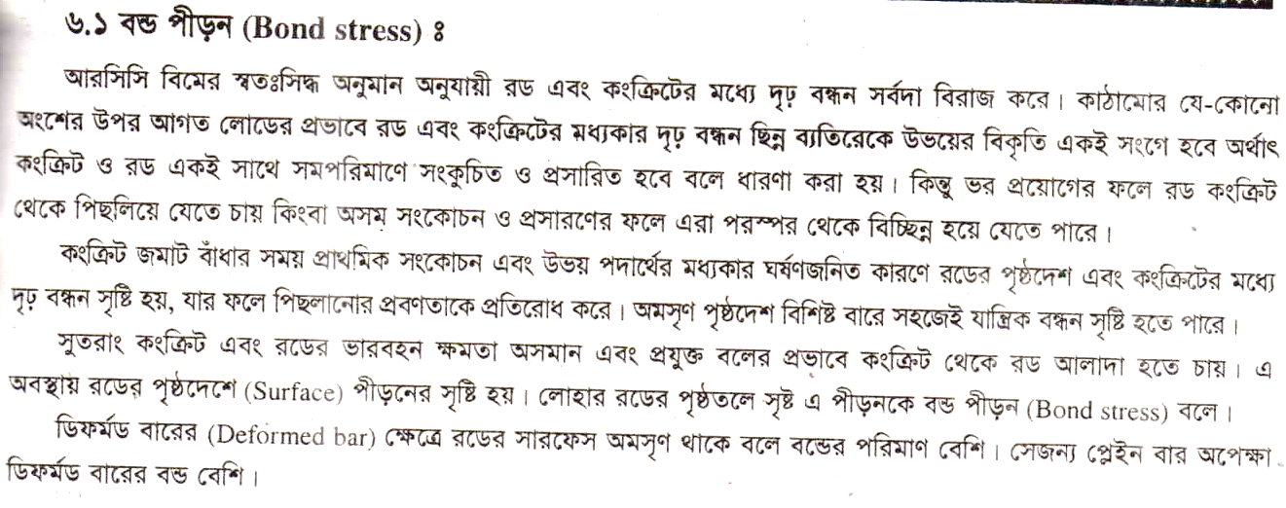
Presentation of lesson

Slide 13
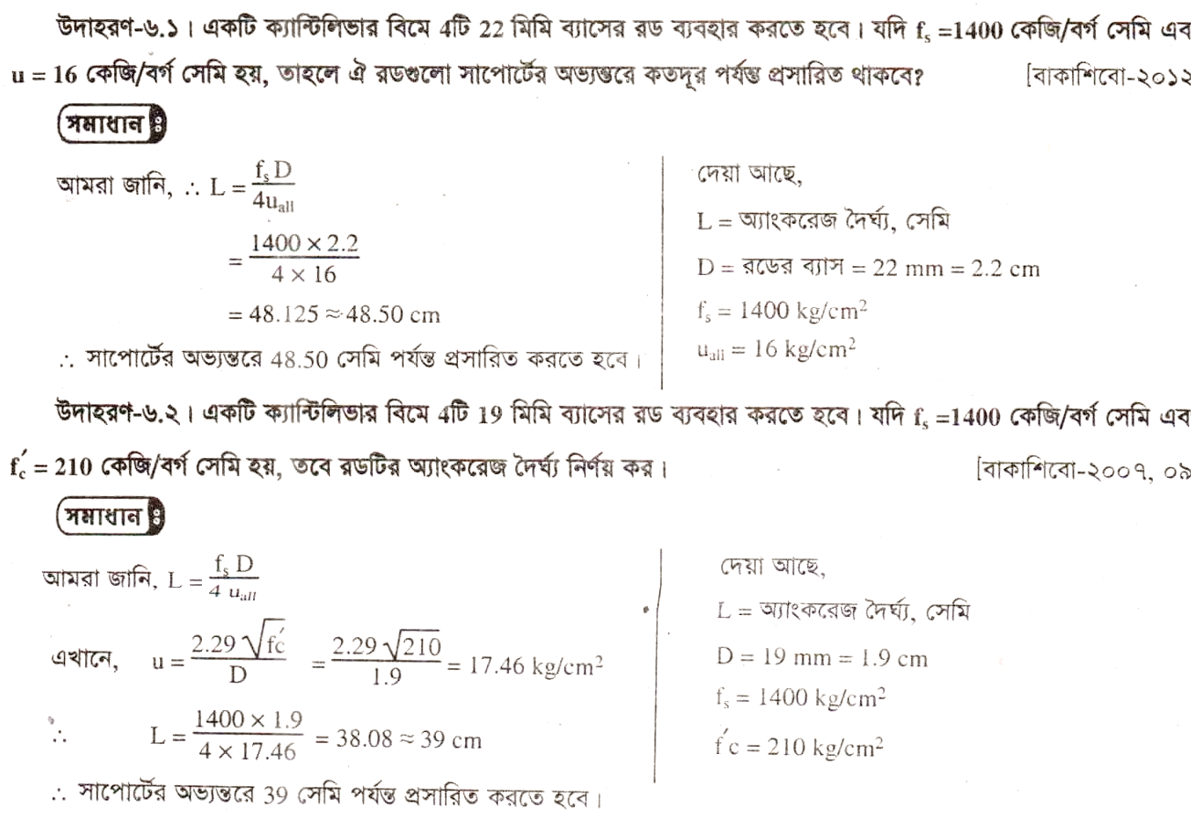

Slide 14
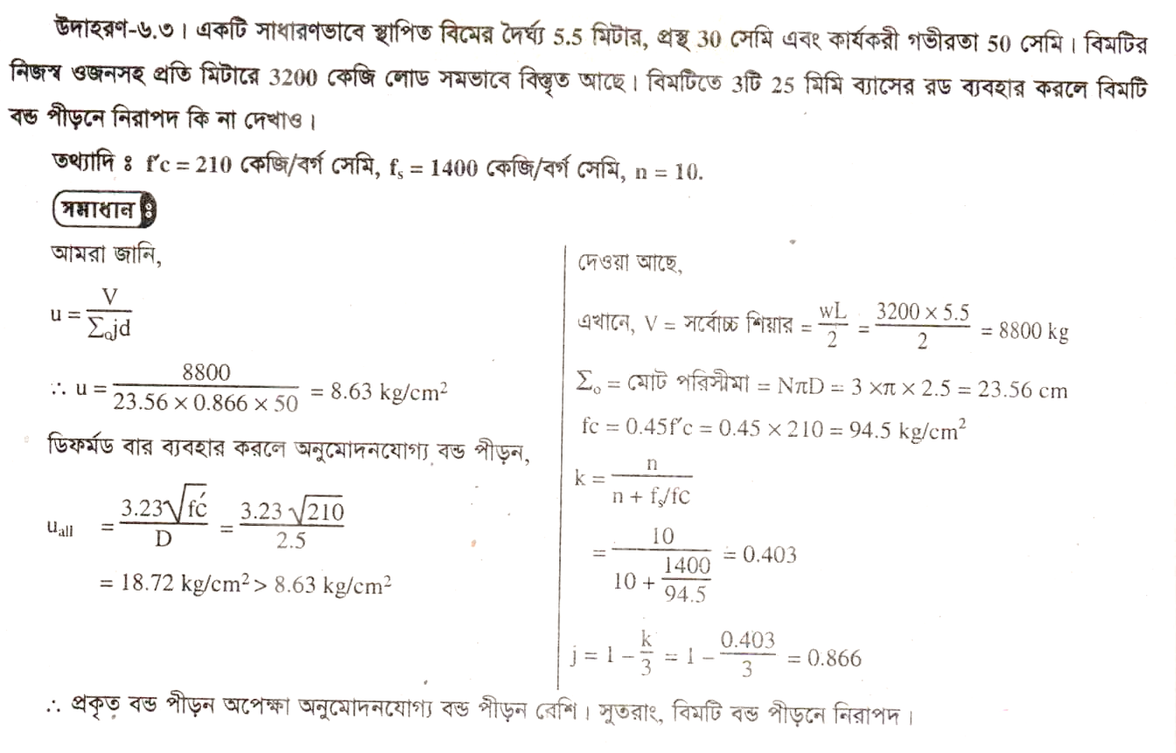

Slide 15
Evaluation
What is Stirrup .
What is Diagonal tension.
What is Critical shear.
What is Shear stress.
What is causes of diagonal tension.
What is prevantation of diagonal tension.

Slide 16
Home Work
Solve the problem of Bond Stress.

Slide 17
Next Lesson
(Flexure formula and Design of RCC Rectangular beam in WSD.

Slide 18
THANKS TO ALL

